Slide 1

6th Grade Accelerated Math
Unit 1, Lesson 2 Finding the Least Common Multiple Volume 1, pg. 9

Slide 2


Benchmark
MA.6.NSO.3.1
Given a mathematical or real-world context, find the greatest common factor and least common multiple of two whole numbers.
volume 1, pg. 9

Slide 3
Integrated Mathematical Thinking and Reasoning Standards
MA.K12.MTR.5.1 Use patterns and structure to help understand and connect mathematical concepts.
MA.K12.MTR.7.1 Apply mathematics to real-world contexts.
volume 1, pg. 9

Slide 4

Learning Target
I can find the least common multiple (LCM) in mathematical and real-world contexts.
volume 1, pg. 9

Slide 5

Warm-Up
volume 1, pg. 9

Slide 6

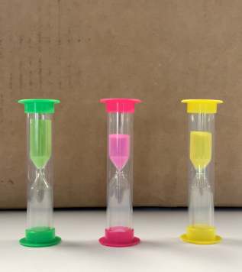
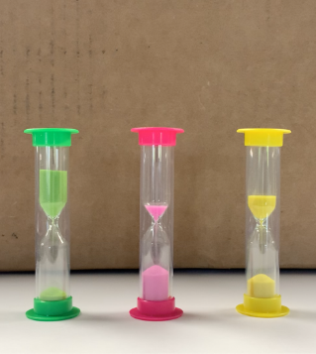
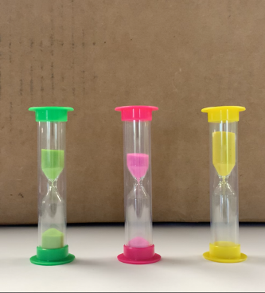
1.2.1 Warm-Up: Hourglass Timing
The video shows three different hourglass sand timers. The timers are all started at the same time. As one of the times runs out, it is flipped over again to restart.
Several screenshots taken from the video are shown.
00:00:19.45
00:01:56.80
00:03:02.78
volume 1, pg. 9

Slide 7
Write one question you have as you watch the video or review the images.
Compare questions with your partner.
Record your partner’s question in the table and have them initial that you recorded it correctly. If you had the same question, work with your partner to generate a different question to ask about the video. You are the only person who should write in the first column of the table.
My Partner’s Question From the Video | Initials
volume 1, pg. 9

Slide 8

Guided Instruction
volume 1, pg. 10

Slide 9
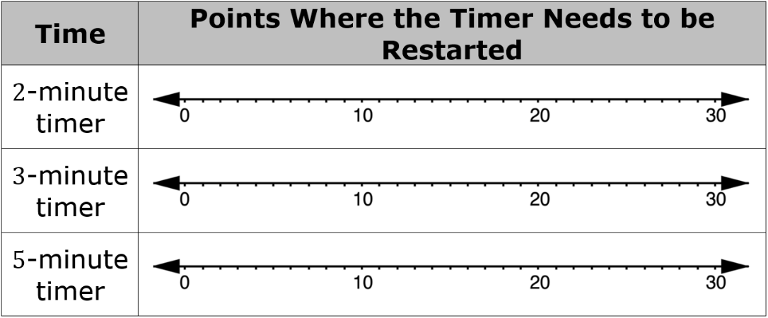
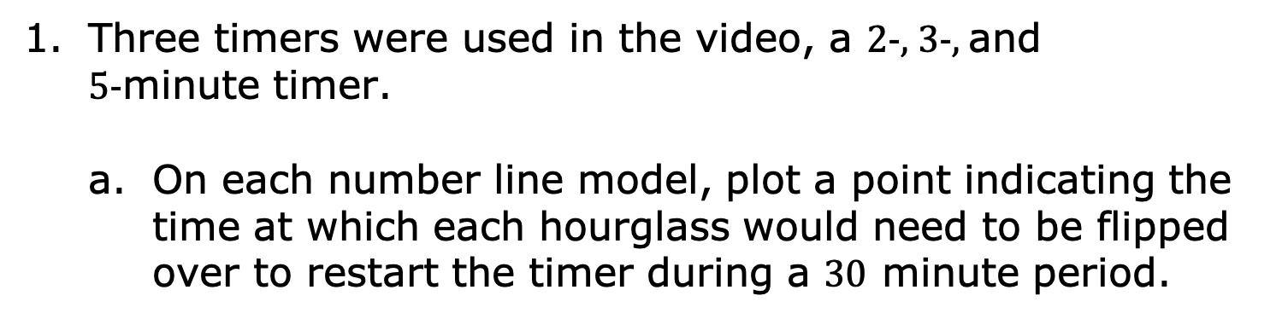
1.2.2 Guided Instruction: Least Common Multiple
Three timers were used in the video, a $2$-, $3$-, and $5$-minute timer.
On each number line model, plot a point indicating the time at which each hourglass would need to be flipped over to restart the timer during a $30$ minute period.
volume 1, pg. 10

Slide 10


What do you notice about the times plotted on the number line for each timer?
For example, the multiples of $2$ are $2$, $4$, $6$, $8, …$ .
Multiples of positive whole numbers are the product of that number multiplied by a positive whole number.
The ellipses (…) at the end of the list of multiples means that the list continues beyond the last number listed. There are an infinite number of multiples for any given whole number.
volume 1, pg. 10

Slide 11
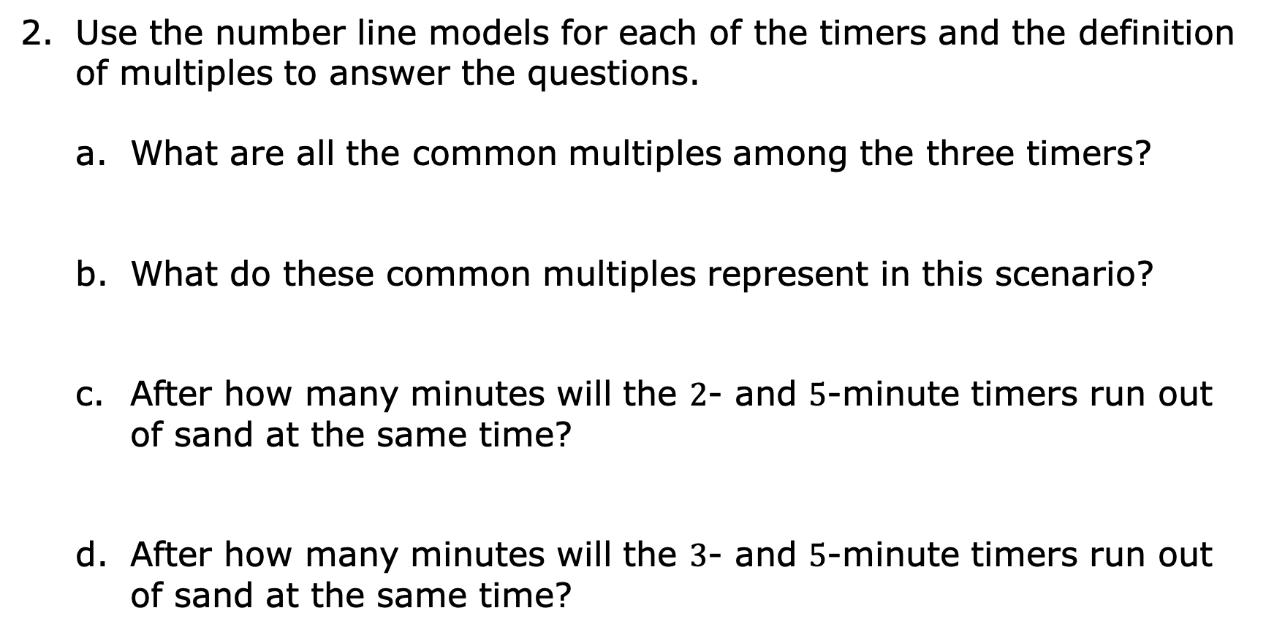
Use the number line models for each of the timers and the definition of multiples to answer the questions.
What are all the common multiples among the three timers?
What do these common multiples represent in this scenario?
After how many minutes will the $2$- and $5$-minute timers run out of sand at the same time?
After how many minutes will the $3$- and $5$-minute timers run out of sand at the same time?
volume 1, pg. 10

Slide 12

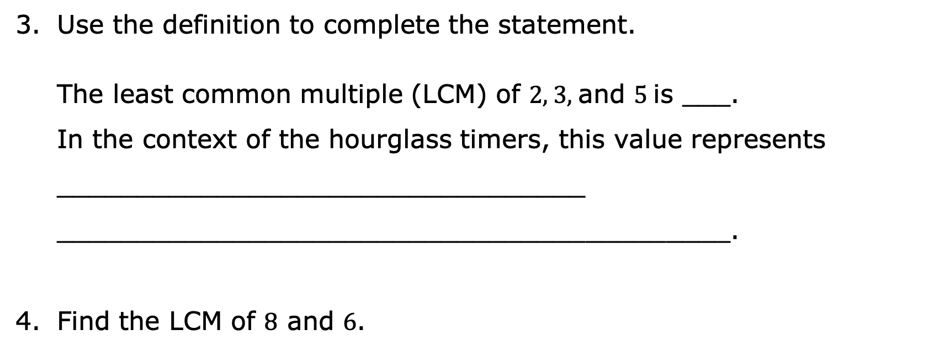
The Least Common Multiple, or LCM, is the lowest number that is a multiple of two or more given numbers.
Use the definition to complete the statement.
The least common multiple (LCM) of $2$, $3$, and $5$ is ___.
In the context of the hourglass timers, this value represents _________________________________
__________________________________________.
Find the LCM of 8 and 6.
volume 1, pg. 11

Slide 13

Try It
volume 1, pg. 11

Slide 14

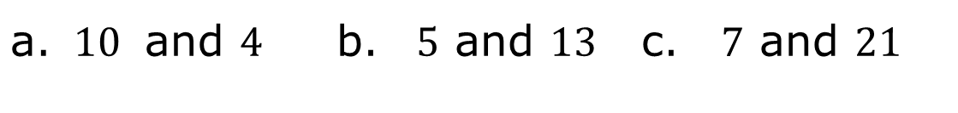
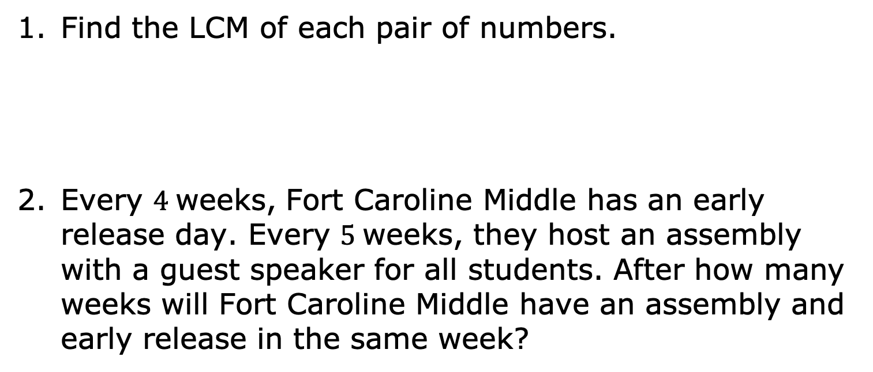
1.2.3 Try It: Least Common Multiple
Find the LCM of each pair of numbers.
Every $4$ weeks, Fort Caroline Middle has an early release day. Every $5$weeks, they host an assembly with a guest speaker for all students. After how many weeks will Fort Caroline Middle have an assembly and early release in the same week?
$10$ and $4$ | $5$ and $13$ | $7$ and $21$
volume 1, pg. 11

Slide 15
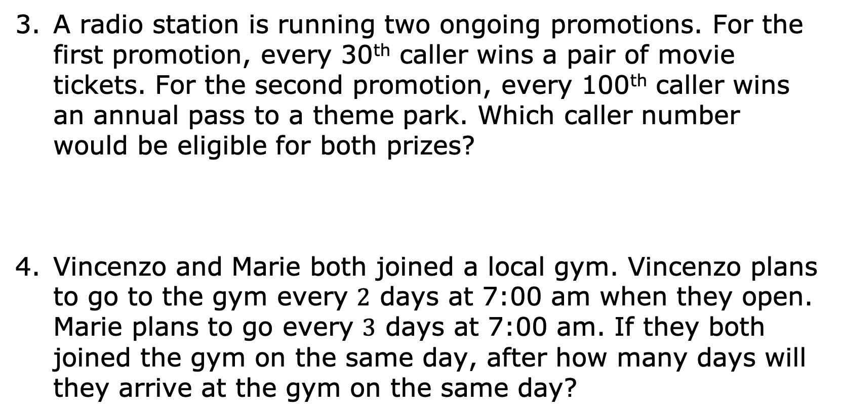
A radio station is running two ongoing promotions. For the first promotion, every 30th caller wins a pair of movie tickets. For the second promotion, every 100th caller wins an annual pass to a theme park. Which caller number would be eligible for both prizes?
Vincenzo and Marie both joined a local gym. Vincenzo plans to go to the gym every $2$ days at 7:00 am when they open. Marie plans to go every $3$ days at 7:00 am. If they both joined the gym on the same day, after how many days will they arrive at the gym on the same day?
volume 1, pg. 12

Slide 16

Collaboration
volume 1, pg. 12

Slide 17

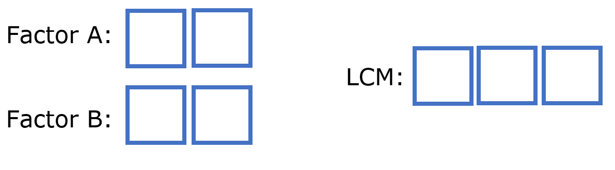
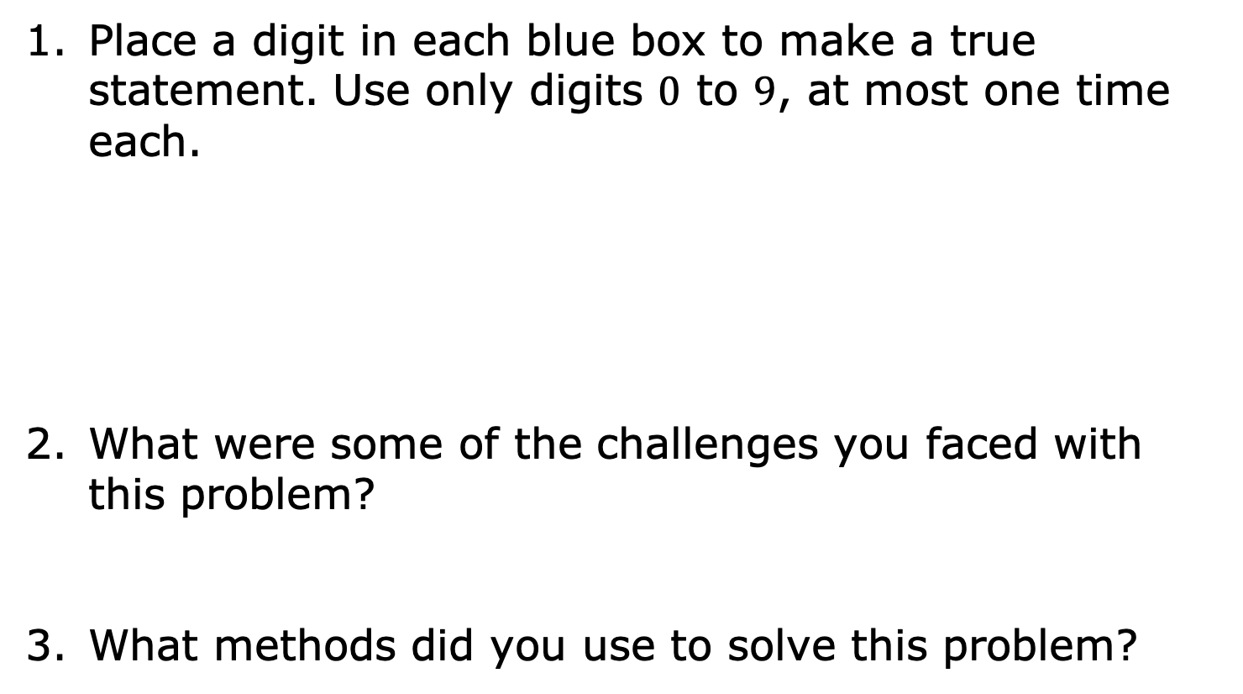
1.2.4 Collaboration: Least Common Multiple
Place a digit in each blue box to make a true statement. Use only digits $0$ to $9$, at most one time each.
What were some of the challenges you faced with this problem?
What methods did you use to solve this problem?
volume 1, pg. 12

Slide 18

Your Turn
volume 1, pg. 13

Slide 19
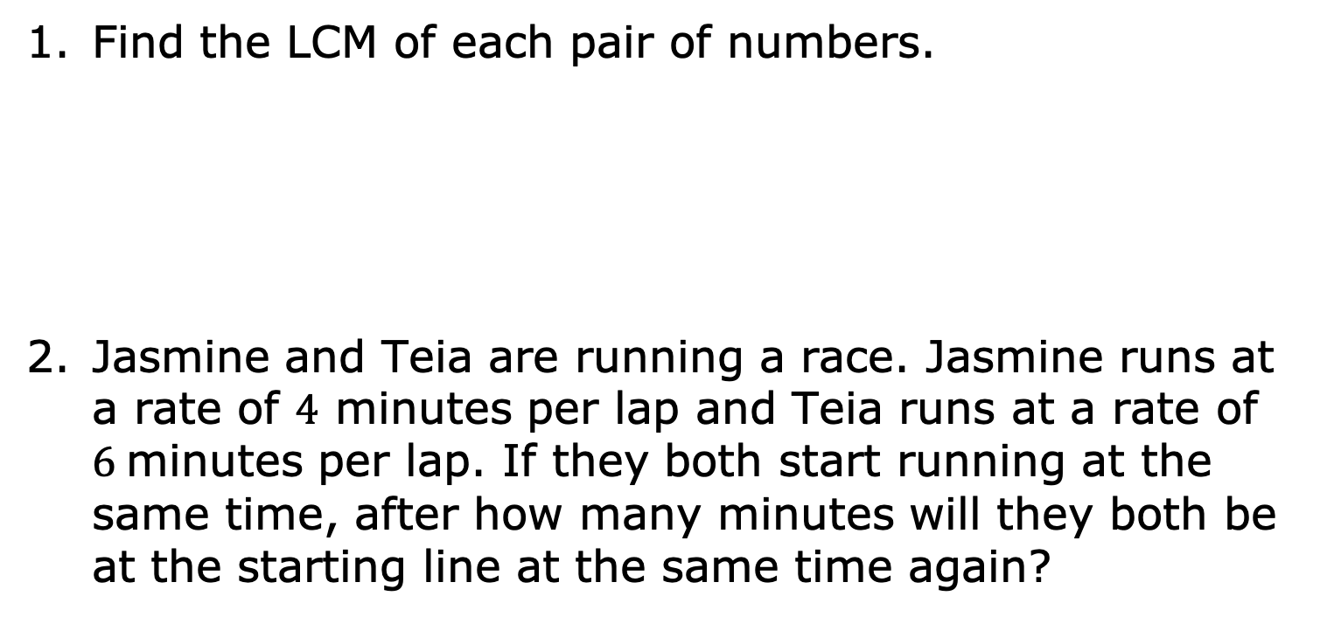
1.2.5 Your Turn!
Find the LCM of each pair of numbers.
Jasmine and Teia are running a race. Jasmine runs at a rate of $4$ minutes per lap and Teia runs at a rate of $6$minutes per lap. If they both start running at the same time, after how many minutes will they both be at the starting line at the same time again?
$15$ and $20$ | $18$ and $24$ | $22$ and $11$
volume 1, pg. 13

Slide 20
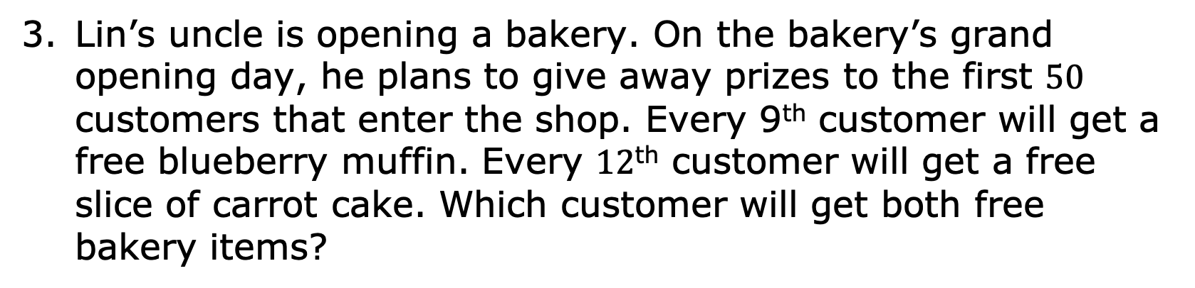
Lin’s uncle is opening a bakery. On the bakery’s grand opening day, he plans to give away prizes to the first $50$ customers that enter the shop. Every 9th customer will get a free blueberry muffin. Every $12$^{th} customer will get a free slice of carrot cake. Which customer will get both free bakery items?
volume 1, pg. 13

Slide 21

Wrap-Up
volume 1, pg. 14

Slide 22
1.2.6 Wrap-Up: Reflection
Rate your level of mathematical confidence on the concepts listed by circling the statement that best describes your understanding.
Greatest Common Factor (GCF)
Least Common Multiple (LCM)
I don’t know what GCF is. | I need a little more practice. | I am okay at this. | I’m pretty good at this. | I could teach this.
I don’t know what LCM is. | I need a little more practice. | I am okay at this. | I’m pretty good at this. | I could teach this.
volume 1, pg. 14

